Slide 1
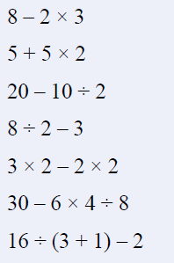
BIMDAS
Notes:
hook

Slide 2
Answers
2
15
15
1
2
27
2

Slide 3
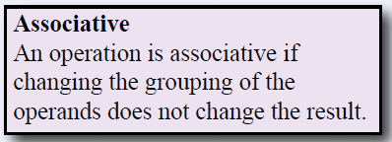
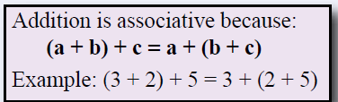
24
7
30
Date
Associative law
EQ – Which of the four operations are associative?
5
Notes:
Lesson objective (EQ)

Slide 4
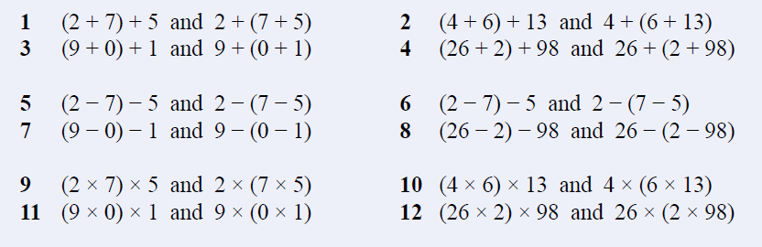
Investigate:
Which of the four operations are associative
Notes:
Check for understanding

Slide 5
Which operations are associative?
What about Subtraction, Multiplication and division?
How do you know this?
Notes:
Class discussion

Slide 6
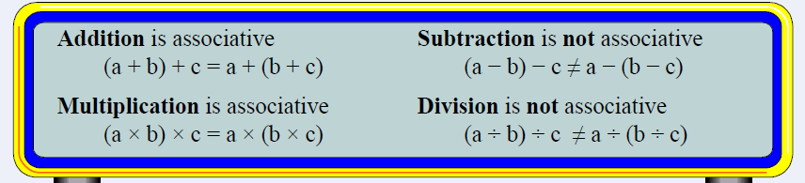
Notes:
Add to their notes

Slide 7
24
7
30
Date
Associative law
EQ – Which of the four operations are associative?
5

Slide 8
Closure activity
Add this to your notes and write your summary.
Notes:
Closure

